Slide 1
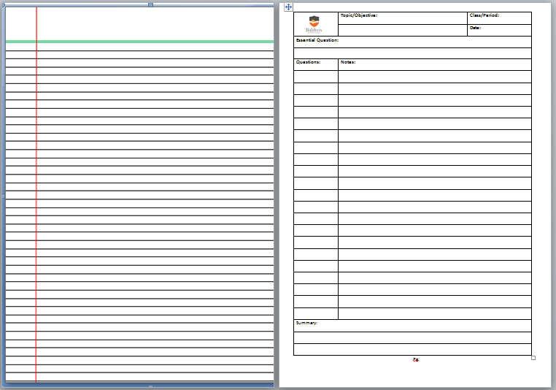
Rule up new page.

Slide 2
Topic:
Adding and Subtracting Directed numbers
EQ:
How do I add and subtract directed numbers

Slide 3
What happens when we…
Add and
Subtract
Negative numbers?

Slide 4


I would like to introduce you to…
A S S
and
S I D

Slide 5
ASS
Add Same Signs
+
8 - ⁻ 6 =
14
Look at the signs in the middle, if they are the same, then replace them with +

Slide 6
SID
Subtract If Different
-
8 + ⁻ 6 =
2
Look at the signs in the middle, if they are different, then replace them with -

Slide 7
Sometimes Textbooks give a number in a bracket
5 + (⁻2)
= 5 + ⁻2
Sometimes Textbooks give the sign NOT raised
5 + (-2)
= 5 + (⁻2)
= 5 - ⁺2

Slide 8
Examples:
3 + ⁻ 9 =
3 - 9
Start
= -6
Direction
How you walk
3 – (⁻ 9) =
3 + 9
= 12

Slide 9
Basic Rules
ADD a POSITIVE means ADD
+ ⁺3 = + 3
ADD a NEGATIVE means SUBTRACT
+ ⁻3 = - 3
SUBTRACT a POSITIVE means SUBTRACT
- ⁺3 = - 3
SUBTRACT a NEGATIVE means ADD
- ⁻3 = + 3

Slide 10
Questions:
Exercise 2.4, 2.5 and 2.6 from Dwyer

